Slide 1
Injury Assessment
Chapter 5

Slide 2
Injury Evaluation Process
Symptom
Information provided by the injured person regarding their perception of the problem
Sign
Objective, measurable physical finding
Notes:
Injury evaluation—symptoms and signs are used to determine the extent of the injury
Examples of symptoms: blurred vision, ringing in the ears, fatigue, dizziness, nausea, headache, pain, weakness, and the inability to move a body part
Signs: what the evaluator hears, feels, sees, or smells when assessing the patient

Slide 3
Injury Evaluation Process (cont.)
Establish a reference point by assessing the opposite, noninjured body part
Methods
HOPS
Subjective – history
Objective – observation, palpation, special tests
SOAP
Subjective and objective – same as HOPS
Additional – assessment and planning
Common abbreviations - refer to Table 5.1
Notes:
Prior to assessing any injury, the noninjured body part should be assessed
-- serves to establish a reference point to help determine the relative dysfunction of the injured body part
-- can also be used as a reference point to determine extent of injury rehabilitation
Typically, assessment of a noninjured part should precede assessment of the injured part; but, in some acute injuries (e.g., fractures or dislocations), assessment of the noninjured part isn’t necessary
Injury evaluation process must include several key components:
-- taking a history of the current condition
-- visually inspecting the area for noticeable abnormalities
-- physically palpating the region for abnormalities
-- completing functional and stress tests
Popular methods: HOPS format and SOAP note format
-- each has its advantages, but the SOAP note format is much more inclusive of the entire injury management process

Slide 4
Injury Evaluation Process (cont.)
Assessment
suspected site of injury, involved structures, and severity of injury
Establish long and short term goals
Plan
therapeutic modalities and exercises, educational consultations, and functional activities
Actionplan for achieving goals
Notes:
Following the objective evaluation, the examiner analyzes and assesses the individual’s status and prognosis. …definitive diagnosis may not be known, the suspected site of injury, involved structures, and severity of injury are documented
Long-term goals
reflect the anticipated status of the individual after a period of rehabilitation
Possible: pain-free ROM; bilateral strength, power, and muscular endurance; cardiovascular endurance; and return to full functional status
Short-term
outline the expected progress within days of the initial injury
Possibilities: immediate protection of the injured area and control of inflammation, hemorrhage, muscle spasm, or pain.
updated with each progress note…. Progress notes may be written daily, weekly, or biweekly to document progress.
Action plan:
The action plan should include the following information:
immediate treatment given to the injured individual
frequency and duration of treatments, therapeutic modalities, and exercises
evaluation standards to determine progress toward the goals
ongoing patient education
criteria for discharge

Slide 5
Injury Evaluation Process (cont.)
All clinicians have an ethical responsibility to keep accurate and factual records
Injury Assessment Protocol – refer to Application Strategy 5.1
Notes:
This information verifies specific services rendered and evaluates the progress of the patient as well as the efficacy of the treatment plan.
Insurance companies use this information to determine if services are being appropriately rendered and qualify for reimbursement.
More important, this comprehensive record-keeping system can minimize the ever-present threat of malpractice and litigation.
In general, the primary error in writing SOAP notes is the error of omission, whereby clinicians fail to adequately document the nature and extent of care provided to the patient. Formal documentation and regular review of records can reduce this threat and minimize the likelihood that inappropriate or inadequate care is being rendered to a patient.

Slide 6
History of Injury
Can be most important step in assessment
Involves not only asking questions, but establishing a professional and comfortable atmosphere
Information provided is subjective, but should be gathered and recorded as quantitatively as possible
Document history in writing
Includes:
Primary complaint
Mechanism of injury
Characteristics of symptoms
Related medical history
Notes:
Identifying the history of the injury can be the most important step in injury assessment
History can:
-- provide possible reasons for the symptoms
-- identify possible injured structures prior to initiating the physical examination
Medical history file can be an excellent resource for identifying:
-- past injuries
-- subsequent rehabilitation programs
-- any factors that may predispose the athlete to further injury
History taking involves asking appropriate questions, but also requires establishing a professional and comfortable atmosphere;
-- potential obstacle: sociocultural dynamics between the patient and clinician that can hinder communication; must understand and respect cultural groups’ attitudes, beliefs, and values as related to health and illness
History begins by gathering general information, such as the individual’s name, sex, age, date of birth, occupation, and the activity in which the individual was participating when the injury occurred; notes regarding body size, body type, and general physical condition are also appropriate.
When possible, convert subjective information to quantitative; this can be accomplished by recording a number correlating with the described symptoms.
-- example: when asking about pain, the individual can rate the severity of pain using a scale from 1 to 10, with 10 being the most severe pain.
Although the intent of history is to narrow the possibilities, it should always be taken with an open mind; if too few factors are considered, may reach premature conclusions and fail to adequately address the severity of injury.
Evaluator must realize the individual may not want to carry on a lengthy discussion or may trivialize the extent of pain or disability; must be patient and keep questions simple and open-ended; pay close attention to words and gestures that may provide clues to the quality and intensity of the symptoms
It is essential to document in writing the information obtained during the history!!!

Slide 7
History of Injury (cont.)
Primary complaint
What the individual believes is the current injury
Questions
Mechanism of injury
Attempt to visualize injury to identify possible injured structures
Questions
Notes:
Primary complaint
Questions should be phrased to allow the individual to describe the current nature, location, and onset of the condition
Why are you here?
What is the problem?
Where does it hurt?
What activities or motions are weak or painful?
Mechanism of injury
Probably the most important information gained in the history
Important to visualize how the injury occurred to identify possible injured structures
How did the injury occur?
Did you fall? if so, how did you land?
Were you struck by an object or another individual? If so, in what position was the involved body part, and what direction was the force?
Did you hear or feel anything?
How long has the injury been a problem?
Have there been recent changes in running surface, shoes, equipment, techniques, or conditioning modes?
It is important to visualize how the injury occurred to identify possible injured structures; this directs the objective evaluation.

Slide 8
History of Injury (cont.)
Characteristics of symptoms
Location, onset, severity, frequency, duration, limitations due to pain
Questions
Pain
Somatic
Deep
Diffuse or nagging; with possible stabbing pain; longer lasting
Injury to bone, internal joint structures, or muscles
Superficial
Sharp, prickly; brief duration
Injury to skin
Visceral
Deep, nagging, and pressing; often accompanied by nausea and vomiting
Injury to internal organ
Referred pain
Notes:
Primary complaint must be explored in detail to discover the evolution of symptoms, including the location, onset, severity, frequency, duration, and limitations due to the pain or disability.
Questions
about the location, onset, nature, severity, frequency, and duration of the pain
Where does it hurt the most?
Can you point to a specific spot?
Is the pain limited to that area, or does it radiate into other parts of the leg or foot?
On a scale from 1 to 10 with 10 being most severe, how bad is the pain?
Can you describe the pain (e.g., dull, sharp, aching)?
In chronic conditions, the following questions should be asked:
When does the pain begin (when you get out of bed, while sitting, while walking, during exercise, or at night)?
How long does the pain last?
Is the pain worse before, during, or after activity?
What activities aggravate or alleviate the symptoms?
Does it wake you up at night?
How long has the condition been present?
Has the pain changed or stayed the same?
In the past, what medications, treatments, or exercise programs have improved the situation?
Localized pain: suggests limited bony or soft tissue structures may be involved
Diffuse pain around the entire joint: may indicate inflammation of the joint capsule or injury to several structures
Pain that radiates into other areas body, may be traveling up or down the length of a nerve

Slide 9
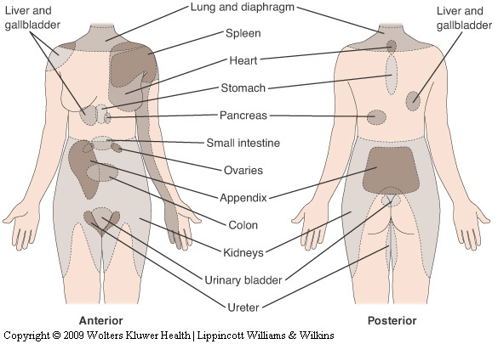
History of Injury (cont.)
Visceral organs can refer pain to specific cutaneous areas
Notes:
Referred pain
-- type of visceral pain that travels along the same nerve pathways as somatic pain; perceived by the brain as somatic in origin (i.e., the injury is in one region but the brain considers it in another)
-- examples: when an individual has a heart attack and feels pain in the chest, left arm, and sometimes the neck; an individual who has a low back problem may feel the pain down the gluteal region into the back of the leg

Slide 10
History of Injury (cont.)
Disability resulting from injury
Determine limitations due to pain, weakness, or disability
Questions
Related medical history
Information regarding other problems/conditions potentially affecting this injury
Use of preseason physical exam
Notes:
Disability resulting from injury
-- attempt to determine the limitations of the individual due to pain, weakness, or disability from the injury; questions should not be limited to sport and physical activity, but include whether the injury has affected the patient’s job, school, or ADLs
Related medical history
-- obtain information regarding other conditions that might have affected this injury; preseason physical examination may help verify some information
-- previous injuries or congenital abnormalities may predispose individual to certain injuries
-- AT should ask if the individual is taking any medication; the type, frequency, dosage, and effect of a medication may mask some symptoms

Slide 11
Observation and Inspection
Observation
Assess state of consciousness and body language that may indicate pain, disability, or other conditions
Note posture, willingness/ability to move, overall attitude
Symmetry and appearance
Congenital and functional problems
Gait
Motor function
Assess general motor function
Rule out injury to other joints
Notes:
Observation and inspection begin the objective evaluation in an injury assessment.
Observation: visual analysis of overall appearance, symmetry, general motor function, posture, and gait
Inspection: factors seen at the actual injury site (e.g., redness, bruising, swelling, cuts, or scars)
Observation
-- begins the moment the injured person is seen and continues throughout the assessment
-- initially, assess the individual’s state of consciousness and body language that may indicate pain, disability, fracture, dislocation, or other conditions
-- note the individual’s general posture, willingness and ability to move, ease in motion, and general overall attitude
-- using discretion in safeguarding the individual’s privacy, the injured area should be fully exposed
-- scan the body visually to detect congenital (existing at birth) or functional problems that may be contributing to the injury
-- if not contraindicated, observe the normal swing of the individual’s arms and legs during walking
-- observe from all angles
-- perform a scan exam to assess general motor function; observe individual doing gross motor movements in the neck, trunk, and extremities

Slide 12
Observation and Inspection (cont.)
Inspection
Factors seen at the actual injury site (e.g., deformity, discoloration, swelling, signs of infection, scars)
Notes:
Localized injury site is inspected for:
-- deformity
-- swelling (edema or joint effusion)
-- discoloration (redness, pallor, bruising, or ecchymosis)
-- signs of infection (redness, swelling, pus, red streaks, swollen lymph nodes)
-- scars that might indicate previous surgery
-- general skin condition (oily, dry, blotchy with red spots, sores, or hives)
joint effusion: swelling inside the joint; localized intra-articular swelling; makes the joint appear enlarged, red, and puffy
Amount of swelling should be measured in a quantifiable manner using girth measurements.
Ecchymosis: discoloration or swelling outside the joint in the surrounding soft tissue due to a bruise or injury under the skin

Slide 13
Palpation
Prior to contact, permission must be granted to the AT to touch the patient
Bilateral palpation
Temperature
Swelling
Point tenderness
Crepitus
Deformity
Muscle spasm
Cutaneous sensation
Pulse
Gentle, circular pressure followed by gradual, deeper pressure
Begin away from injured site and move toward injury
Notes:
Skin temperature
-- increased temperature could indicate inflammation or infection
-- decreased temperature could indicate a reduction in circulation
Swelling can be diffuse or localized in a small area; if swelling is inside the joint, motion will often be limited because of congestion caused by extra fluid.
Possible fractures can be assessed with percussion, vibrations through use of a tuning fork, compression, and distraction.
Point tenderness and crepitus (crackling sensation)
-- may indicate a fracture when felt over bone
-- may indicate inflammation when felt over a tendon, bursa, or joint capsule
Note any trigger points that may be found in muscle and, when palpated, refer pain to another site.
Assess differences in the density or “feel” of soft tissues that may indicate muscle spasm, hemorrhage, edema, scarring, myositis ossificans, or other conditions.
Cutaneous sensation can be tested by running the fingers along both sides of the body part and asking the patient if it feels the same on both sides; can determine possible nerve involvement, particularly if the individual has numbness or tingling in the limb.
Peripheral pulses are taken distal to an injury to rule out damage to a major artery; common sites: radial pulse at the wrist and dorsalis pedis pulse on the dorsum of the foot.

Slide 14
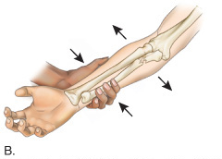
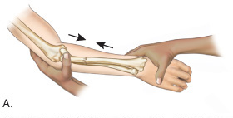
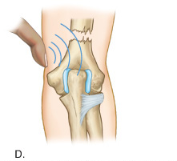
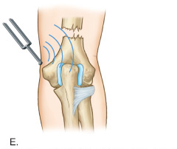
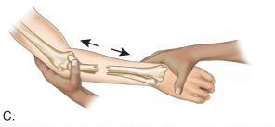
Palpation (cont.)
Determining a possible fracture
Notes:
Skin temperature
-- increased temperature could indicate inflammation or infection
-- decreased temperature could indicate a reduction in circulation
Swelling can be diffuse or localized in a small area; if swelling is inside the joint, motion will often be limited because of congestion caused by extra fluid.
Possible fractures can be assessed with percussion, vibrations through use of a tuning fork, compression, and distraction.
Point tenderness and crepitus (crackling sensation)
-- may indicate a fracture when felt over bone
-- may indicate inflammation when felt over a tendon, bursa, or joint capsule
Note any trigger points that may be found in muscle and, when palpated, refer pain to another site.
Assess differences in the density or “feel” of soft tissues that may indicate muscle spasm, hemorrhage, edema, scarring, myositis ossificans, or other conditions.
Cutaneous sensation can be tested by running the fingers along both sides of the body part and asking the patient if it feels the same on both sides; can determine possible nerve involvement, particularly if the individual has numbness or tingling in the limb.
Peripheral pulses are taken distal to an injury to rule out damage to a major artery; common sites: radial pulse at the wrist and dorsalis pedis pulse on the dorsum of the foot.

Slide 15
Physical Examination Tests
Functional testing
Objectively measure using goniometer
Age and gender may influence ROM
AROM
Joint motion performed voluntarily by the individual through muscular contraction
Perform before PROM
Indicates willingness and ability to move body part
Determines possible damage to contractile tissue; measures muscle strength and movement coordination
Measurement of all motions, except rotation, starts with the body in anatomic position
Notes:
Goniometer
-- a protractor with two rigid arms that intersect at a hinge joint
-- used to measure both joint position and available joint motion
-- arms of the goniometer measure from 0 to 180° of motion, or 0 to 360° of motion
-- measurements are obtained by placing the goniometer’s stationary arm parallel to the proximal bone; axis of the goniometer should coincide with the joint axis of motion; moving arm is then placed parallel to the distal bone, utilizing specific anatomic landmarks as points of reference; normal ROM for selected joints is listed in Table 5.2
Age & gender
-- women in their teens and early 20s tend to have a greater ROM in all planes than men
-- ROM decreases after 20 years in both genders, with the decrease occurring to a greater extent in women
AROM
-- unless contraindicated, AROM should always be performed before PROM
Contractile tissue = muscle, muscle-tendon junction, tendon, and tendon-periosteal union
For rotation, the starting body position is midway between internal (medial) and external (lateral) rotation.
Starting position is measured as 0°; maximal movement away from the 0° point is the total available range of motion; example: subjective measurement of plantar flexion against gravity involves placing the individual prone on a table with the knees flexed; next, both thighs are stabilized against the table, and the individual is instructed to plantarflex both ankles; comparison of movement in both legs will indicate if plantarflexion is bilaterally equal.
It is necessary to assess the individual’s willingness to perform the movement, the fluidity, and extent of movement (joint ROM).
If symptoms are present, note:
-- their location in the arc of movement
-- any increase in intensity or quality of symptoms
Limitation in motion may be due to pain, swelling, muscle spasm, muscle tightness, joint contractures, nerve damage, or mechanical blocks, such as a loose body.
If the individual has pain or other symptoms on motion, it is difficult to determine at this time if the joint, muscle, or both are injured.
Important to assess the following:
-- If motion causes pain, at what point in the motion does pain begin?
-- Does pain appear only in a limited range of motion (painful arc)?
-- Is the pain the same type of pain associated with the primary complaint?
Anticipated painful movements should be performed last to avoid any carryover of pain from testing one motion to the next.

Slide 16
Physical Examination Tests (cont.)
PROM
The injured body part is moved through ROM with no assistance from the injured individual
Distinguishes injury to contractile tissues from noncontractile or inert tissues
End of the range, gentle overpressure to determine end feel
Differences in ROM between AROM and PROM
Accessory movements
Loose-packed position
Close-packed position
Notes:
If the individual is unable to perform all active movements at the injured joint because of pain or spasm, passive movement can be performed.
As PROM is performed, the individual should be positioned to allow the muscles to be in a relaxed state.
Inert tissues = bone, ligament, bursae, joint capsule, fascia, dura mater, and nerve roots
If no pain is present during PROM but present during AROM, contractile tissue is injured
If PROM is painful and there is limitation of movement, noncontractile tissue is injured
At the end of the range of motion, a gentle overpressure is applied to determine end feel; overpressure is repeated several times to determine whether pain increases, which could signify damage to noncontractile joint structures; the end feel can determine the type of disorder; three normal end feel sensations and four abnormal end feel sensations (see Table 5.3)
Differences in ROM between AROM and PROM can be due to:
-- muscle spasm
-- muscle deficiency
-- neurologic deficit
-- contractures
-- pain
pain occurs before the end of the available ROM: may indicate an acute injury; stretching and manipulation of the joint are contraindicated
pain occurs simultaneously at the end of the ROM: a subacute injury may be present; a mild stretching program may be started cautiously
no pain is felt as the available ROM is stretched: a chronic injury is present; an appropriate treatment & rehabilitation program should be initiated immediately
Accessory movements
-- movements within the joint that accompany traditional active and passive ROM, but cannot be voluntarily performed by the individual
-- example: joint play motions allow the joint capsule to “give” so bones can move to absorb an external force
-- movements include distraction, sliding, compression, rolling, and spinning of joint surfaces
-- can occur within the joint, but only as a response to an outside force, and not as a result of any voluntary movement
-- aid the healing process, relieve pain, reduce disability, and restore full normal range of motion
-- presence of accessory movement can be determined by manipulating the joint in the loose-packed or close-packed position
Loose-packed position
-- the position in the joint’s ROM in which the joint is under the least amount of stress
-- the position in which the joint capsule has its greatest capacity
-- advantage to testing in this position: the joint surface contact areas are reduced, proper joint lubrication is enhanced, and friction and erosion in the joints are decreased
Close-packed position
-- the position in which two joint surfaces fit precisely together
-- the ligaments and joint capsule are maximally taut, and joint surfaces are maximally compressed and cannot be separated by distractive forces
-- accessory movements cannot occur, so if a bone or ligament is injured, pain will increase as the joint moves into the close-packed position
-- if swelling is present within the joint, the close-packed position cannot be achieved

Slide 17
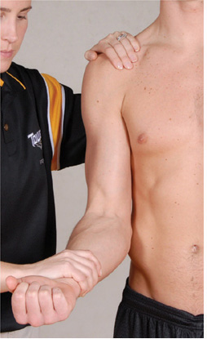
Physical Examination Tests (cont.)
RROM
Can assess muscle strength and detect injury to the nervous system
Break test or entire ROM
Notes:
Muscle weakness and pain indicate a muscular strain.
Muscle weakness in the absence of pain may indicate nerve damage.
Break test
-- overload pressure is applied with the joint in a neutral or relaxed position to relax joint structures and reduce joint stress
-- limb is stabilized proximal to the joint to prevent other motions from compensating for weakness in the involved muscle; resistance is provided distally on the bone to which the muscle or muscle group attaches and should not be distal to a second joint; in a fixed position, the individual is asked to elicit a maximal contraction while the body part is stabilized to prevent little or no joint movement
-- example: to test strength in the elbow flexors, flex the elbow at 90° and stabilize the upper arm against the body; patient is instructed to keep the arm in that position as the examiner applies downward overpressure on the distal forearm
-- pressure should be held for at least 5 seconds and repeated 5 to 6 times to indicate muscle weakening and the presence or absence of pain
-- a standardized grading system can be used to measure muscle contraction, but the results are negated if the contraction causes pain
Testing resistance throughout the full ROM
-- advantages:
1) a better overall assessment of weakness can be determined
2) a painful arc of motion can be located, which might otherwise go undetected if the test is only performed in the midrange
-- body segment is placed in a specific position to isolate the muscle(s); the muscle(s) to be tested is placed in a stretched or elongated position—this position prevents other muscles in the area from performing the movement; manual pressure is exerted throughout the full range of motion; repeat several times to reveal weakness or pain
-- presence of pain during motion should be noted

Slide 18
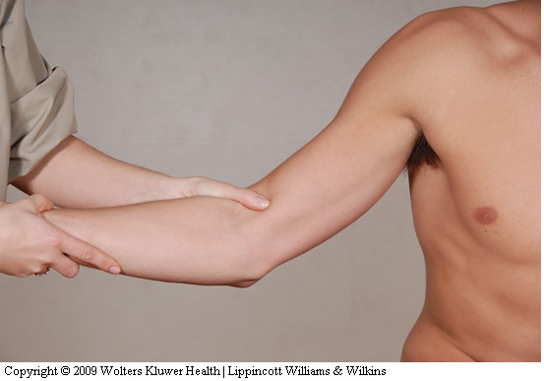
Physical Examination Tests (cont.)
Ligamentous and capsular testing
Assess joint function and integrity of joint structures
Laxity vs. instability
Test at proper angle
Notes:
Ligamentous & capsular testing
-- each body segment has a series of tests to assess joint function and integrity of joint structures
Tests assess:
-- noncontractile tissues (e.g., ligaments, intra-articular structures, joint capsule stability)
-- impingement signs
-- muscle balance
-- vascular integrity
Laxity: the amount of “give” within a joint’s supportive tissue
Instability: joint’s inability to function under the stresses encountered during functional activities
It is essential to perform the test at the proper angle, because a seemingly minor change in the joint angle can significantly alter the laxity of the tissue being stressed.
During an on-site assessment, tests to determine a possible fracture and major ligament damage at a joint should always be performed before moving an injured individual.

Slide 19
Physical Examination Tests (cont.)
Neurologic testing
Nerve root
Somatic
Visceral
CNS: assess using dermatomes, myotomes, and reflexes
Dermatome – area of skin supplied by a single nerve root
Assess sensation
Abnormal: hypoesthesia, hyperesthesia, paresthesia
Notes:
Segmental nerve: the portion of nerve originating in the spinal cord; referred to as a nerve root
Most nerve roots share two components:
1) somatic portion: innervates a series of skeletal muscles and provides sensory input from the skin, fascia, muscles, and joints
2) Visceral component: part of the autonomic nervous system; supplies the blood vessels, dura mater, periosteum, ligaments, and intervertebral discs, among many other structures
Motor component of a segmental nerve is tested using a myotome—a group of muscles primarily innervated by a single nerve root.
Sensory component is tested using a dermatome—an area of skin supplied by a single nerve root.
Injury to a segmental nerve root will often affect more than one peripheral nerve and will not demonstrate the same motor loss or sensory deficit as an injury to a single peripheral nerve.
Dermatomes
-- sensitivity assessed by touching the person with a cotton ball, paper clip, pads of the fingers, and fingernails; ask the individual about the sensations being experienced; important to determine the nature of the sensation (e.g., a sharp or dull sensation) and to assess whether the same sensation was experienced in testing the uninjured body segment
Hypoesthesia: decreased tactile sensation
Hyperesthesia: excessive tactile sensation
Anesthesia: loss of sensation
Paresthesia: characterized by a numbness, tingling, or burning sensation

Slide 20
Physical Examination Tests (cont.)
The cutaneous sensation patterns of the spinal nerves’ dermatomes differ from the patterns innervated by the peripheral nerves.

Slide 21
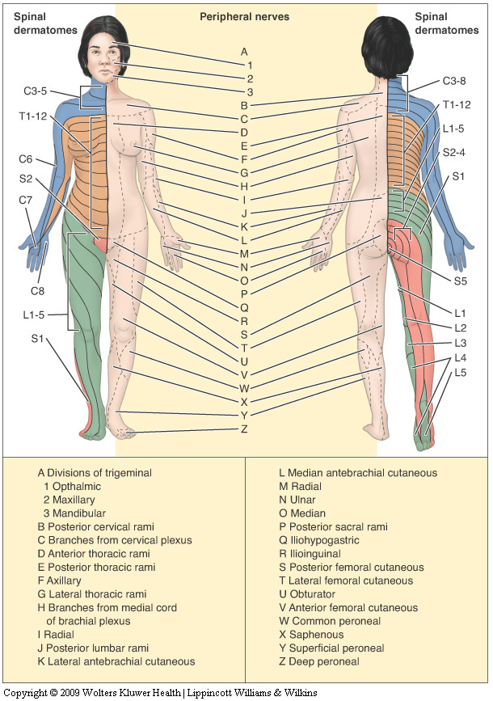
Physical Examination Tests (cont.)

Slide 22
Physical Examination Tests (cont.)
Neurologic testing (cont.)
myotome – group of muscles primarily innervated by a single nerve root
Assess muscle contraction (hold at least 5 seconds)
Abnormal: paresis, paralysis
Notes:
Myotomes
Majority of muscles receive segmental innervation from two or more nerve roots; however, selected motions may be innervated predominantly by a single nerve root (myotome).
Resisted muscle testing of a selected motion determines the status of the nerve root that supplies that myotome.
-- weakness in the myotome indicates a possible spinal cord nerve root injury
-- weakened muscle contraction may indicate partial paralysis (paresis) of the muscles
-- in a peripheral nerve injury, there is complete paralysis of the muscles supplied by that nerve; example: the L3 myotome is tested with knee extension; if the L3 nerve root is damaged at its origin in the spine, there is a weak muscle contraction because the quadriceps muscle receives nerve root innervation from L2 and L4 segmental nerves; if the peripheral femoral nerve, which contains segments of L2, L3, and L4, is damaged proximal to the quadriceps muscle, the muscle cannot receive any nerve impulses and will be unable to contract to execute knee extension
Reflexes:
Deep tendon reflexes (DTRs)
-- assess damage to CNS (reflex testing is limited as not all nerve roots have a DTR)
-- example: deep tendon reflex is the patellar, or knee jerk, reflex elicited by striking the patellar tendon with a reflex hammer, causing a rapid contraction of the quadriceps muscle
-- DTRs tend to be diminished or absent if the specific nerve root is damaged
-- Exaggerated, distorted, or absent DTRs indicate degeneration or injury in specific regions of the nervous system; may be demonstrated before other signs are apparent
- Abnormal DTRs are not clinically relevant unless they are found with sensory or motor abnormalities
Superficial reflexes
-- reflexes provoked by superficial stroking, usually with a moderately sharp object that does not break the skin; this action produces a reflex muscle contraction
-- absence of a superficial reflex indicates a lesion in the cerebral cortex of the brain (upper motor neuron lesion)
Pathologic reflexes
-- may indicate upper motor neuron lesions if bilateral, or lower motor neuron lesions if unilateral
-- presence often serves as a sign of some pathologic condition

Slide 23
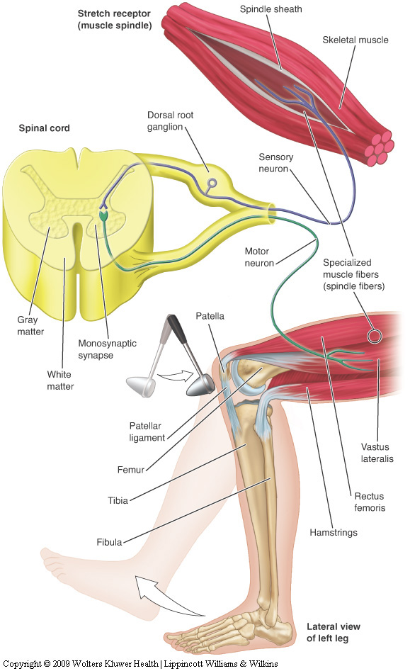
Physical Examination Tests (cont.)
Neurologic testing (cont.)
Reflexes
DTRs
Abnormal: diminished, exaggerated or distorted, absent
Superficial reflexes
Pathologic
Notes:
Myotomes
Majority of muscles receive segmental innervation from two or more nerve roots; however, selected motions may be innervated predominantly by a single nerve root (myotome).
Resisted muscle testing of a selected motion determines the status of the nerve root that supplies that myotome.
-- weakness in the myotome indicates a possible spinal cord nerve root injury
-- weakened muscle contraction may indicate partial paralysis (paresis) of the muscles
-- in a peripheral nerve injury, there is complete paralysis of the muscles supplied by that nerve; example: the L3 myotome is tested with knee extension; if the L3 nerve root is damaged at its origin in the spine, there is a weak muscle contraction because the quadriceps muscle receives nerve root innervation from L2 and L4 segmental nerves; if the peripheral femoral nerve, which contains segments of L2, L3, and L4, is damaged proximal to the quadriceps muscle, the muscle cannot receive any nerve impulses and will be unable to contract to execute knee extension
Reflexes:
Deep tendon reflexes (DTRs)
-- assess damage to CNS (reflex testing is limited as not all nerve roots have a DTR)
-- example: deep tendon reflex is the patellar, or knee jerk, reflex elicited by striking the patellar tendon with a reflex hammer, causing a rapid contraction of the quadriceps muscle
-- DTRs tend to be diminished or absent if the specific nerve root is damaged
-- Exaggerated, distorted, or absent DTRs indicate degeneration or injury in specific regions of the nervous system; may be demonstrated before other signs are apparent
- Abnormal DTRs are not clinically relevant unless they are found with sensory or motor abnormalities
Superficial reflexes
-- reflexes provoked by superficial stroking, usually with a moderately sharp object that does not break the skin; this action produces a reflex muscle contraction
-- absence of a superficial reflex indicates a lesion in the cerebral cortex of the brain (upper motor neuron lesion)
Pathologic reflexes
-- may indicate upper motor neuron lesions if bilateral, or lower motor neuron lesions if unilateral
-- presence often serves as a sign of some pathologic condition

Slide 24
Physical Examination Tests (cont.)
Peripheral nerve testing
Manual muscle testing
Cutaneous sensation testing
Special compression tests
Activity-specific functional testing
Typical, active movements performed during activity participation
Movements should assess: strength, agility, flexibility, joint stability, endurance, coordination, balance, and sport-specific skill performance
Notes:
motor function: assessed with RROM throughout the full range of motion
sensory deficits: assessed identical to dermatome testing, except the cutaneous patterns differ
special compression tests: used on nerves close to the skin surface (e.g., ulnar & median nerves); example, the Tinel’s sign test is performed by tapping the skin directly over a superficial nerve; a positive sign, indicating irritation or compression of the nerve, would result in a tingling sensation traveling into the muscles and skin supplied by the nerve
Activity-specific functional testing
-- activity-specific tests involve the performance of active movements typical of the movements executed by the individual during sport or activity participation
-- in the rehabilitation process, the individual initially performs these skills at low intensity and increases intensity as the individual’s condition improves
-- example: in a lower leg injury, testing should begin by assessing walking, jogging, and then running forward and backward; if these skills are performed pain free and without a limp, the individual might then be asked to run in a figure-eight or zigzag pattern; again, each test must be performed pain free and without a limp

Slide 25
Emergency Medical Services System
Process that activates the emergency health care services of the athletic training facility and community to provide immediate health care to an injured individual
The team physician, athletic trainer, and coach have a legal duty to develop and implement an emergency plan to provide health care for participants
Notes:
As the first responder on the scene, the ATC is expected to evaluate the situation, assess the severity of injury, recognize life-threatening conditions, provide immediate emergency care, and initiate any emergency procedures to ensure the individual is transported to the nearest medical facility without delay; an emergency plan must be in place

Slide 26
Emergency Medical Services System (cont.)
Preseason preparation
Meet with representatives from local EMS agencies to discuss, develop, and evaluate plan
Written plan for each activity site
Practice the emergency plan
Responsibilities of medical personnel
Team physician
Prior to season, delineate responsibilities of all personnel
On-the-field
Athletic trainer
Event set-up
Home vs. away
Presence or absence of physician
Notes:
Preseason prep meeting: excellent opportunity to review individual responsibilities and protocols for an emergency situation; questions to be answered include:
-- What emergency equipment must be available at each event, particularly at contact and collision sporting events?
-- What equipment will be provided by the local EMS agency (spine board, splints, blankets) if in attendance at the event?
-- Who will be responsible for ensuring that all emergency equipment is operational prior to the event?
-- What type of communication will be used to contact emergency personnel, and who will activate EMS?
-- Who will assess the injured individual on-site, and under what circumstances will EMS be called onto the site?
-- If a physician is present, what will be the responsibilities of the athletic trainer(s) and EMS?
-- If a physician is not present and the athletic trainer is evaluating the situation, what are the responsibilities of the EMS?
-- Who will bring supplies or equipment on-site as requested by the athletic trainer or team physician?
-- If it becomes necessary to stabilize and transport the individual to a medical facility, who will direct the stabilization, and what protocol will be followed for the removal of protective equipment?
When an emergency occurs inside a facility with multiple activity areas, several additional questions need to answered prior to rendering care:
-- Who will render emergency care and control the situation?
-- What type of immediate care will this individual initiate while EMS is en route to the facility?
-- Who will supervise the other participants if the athletic trainer is assessing and providing care to the injured individual?
-- Who will be responsible for the proper disposal of items and equipment exposed to blood or other bodily fluids?
Team physician
-- must be clearly understood what events the team physician will attend, their role in the assessment of injuries, and what, if any, responsibilities in providing emergency medical services to bystanders and spectators
-- not always the “first responder,” but once on the field, team physician should:
-- evaluate any serious injury (e.g., head, neck, or spinal injuries, cardiac emergencies, joint injuries) and determine the level of severity
-- summon additional supplies or assistance and direct the athletic trainer to assist as needed
-- direct the stabilization and immobilization in preparation for transportation
-- decide whether to return the individual to competition
AT responsibilities
-- set up event area with appropriate equipment and supplies for the medical kit and emergency “crash” kit
-- provide a method of communication (e.g., telephone, two-way radio, or cellular phone)
-- home events: contact the visiting team’s athletic trainer regarding available services and supplies; away event: be informed of what services will be provided by home team
-- if physician is present: assist as needed; if the team physician is not present, direct the on-site management of all injuries (i.e., stabilize and calm the athlete, assess severity of all injuries, summon additional resources or equipment, manage the injury, direct the stabilization and immobilization of the athlete in preparation for transport, and determine return)

Slide 27
Emergency Injury Assessment
Primary survey
Determines level of responsiveness
Identifies immediate life-threatening situations (ABCs)
Dictates necessary actions
Triage
Rapid assessment of all injured individuals followed by return to the most seriously injured for treatment
Charge person vs. call person
“Red flags”
On-site assessment; ascertain presence of serious or moderate injury
Notes:
Emergency: injuries or conditions that impair, or have the potential to impair, vital function of the CNS and cardiorespiratory system
Charge person: ATC responsible for the team; controls the scene in part by not allowing the athlete to be moved until some type of assessment is completed
Call person: responsible for providing assistance, relaying messages to the sideline, and obtaining additional help if necessary
If at anytime during the assessment “red flags” are noted, the assessment process should be terminated and EMS activated.
“red flags” (Box 5.2) include:
-- airway obstruction
-- respiratory failure
-- severe shock
-- severe chest or abdominal pains
-- excessive bleeding
-- suspected spinal injury
-- head injury with loss of consciousness
-- severe heat illness
-- fractures involving several ribs, the femur, or pelvis
The on-site evaluation should address:
-- inhibition of the cardiovascular and respiratory systems
-- life-threatening trauma to the head or spinal column
-- massive hemorrhage
-- fractures with gross deformity
-- joint dislocations
-- peripheral nerve injury
-- other soft tissue trauma
It is essential to determine the immediate disposition of the condition; includes the on-field management of the injury (e.g., controlling bleeding or immobilizing a possible fracture or dislocation), the safest transportation from the field (e.g., manual conveyance, stretcher, spine board), and the need for rapid referral of the individual for further medical care

Slide 28
Emergency Injury Assessment (cont.)
On-site history
Obtained from the individual or bystanders who witnessed the injury
Relatively brief as compared to a comprehensive clinical evaluation
Critical areas (refer to Field Strategy 5.4)
Location of pain
Presence of abnormal neurologic signs
Mechanism of injury
Associated sounds
History of the injury
Notes:
On-field history: protocols should contain the same basic components that are relevant, accurate, and measurable.
ATC should place one hand on the forehead to stabilize the head and neck to prevent any unnecessary movement.
History critical areas:
location of pain - identify the site of the injury; be aware that other areas may also be injured
presence of abnormal neurologic signs - identify any tingling, numbness, or loss of sensation
mechanism of injury - identify the position of the injured body part at the point of impact and the direction of force
associated sounds - “snap” or “pop” may indicate a fracture or rupture of a ligament or tendon
history of the injury - identify if any pre-existing condition or injury may have exacerbated the current injury or may complicate the assessment of this injury

Slide 29
Emergency Injury Assessment (cont.)
On-site observation and inspection
Begin en route to individual
Critical areas
Surrounding area
Body position
Movement of the athlete
Level of responsiveness
Primary survey
Inspection for head trauma
Inspection of injured body part
Notes:
Observation/inspection of critical areas
surrounding area - determine if any equipment or apparatus contributed to the injury
body position - athlete prone, supine, or side-lying? gross deformity in one of the limbs? severe brain injuries: a neurologic sign - “posturing” of the extremities; decerebrate rigidity - extension in all four extremities; decorticate rigidity - extension of the legs and marked flexion in the elbows, wrists, and fingers
movement of the athlete - athlete holding the injured body part and in pain? - indicates the athlete is conscious and CNS and cardiovascular system are intact and, if athlete is not moving or is having a seizure, suspect possible systemic, psychological, or neurologic dysfunction
level of responsiveness - aka “shake and shout” stage, ATC tries to arouse the unconscious athlete by gently shaking (without moving the head or neck) and shouting into each ear; is person alert, restless, lethargic, or nonresponsive? moan, groan, or mumble?
primary survey - ABC technique to ensure an open airway, adequate breathing, and circulation
inspection for head trauma - pupils normal or dilated? redness, bruising, or discoloration in the facial area or behind the ears? clear fluid or bloody discharge from the ears or nose?
inspection of injured body part - check for joint alignment, redness, swelling, bruising, or cuts

Slide 30
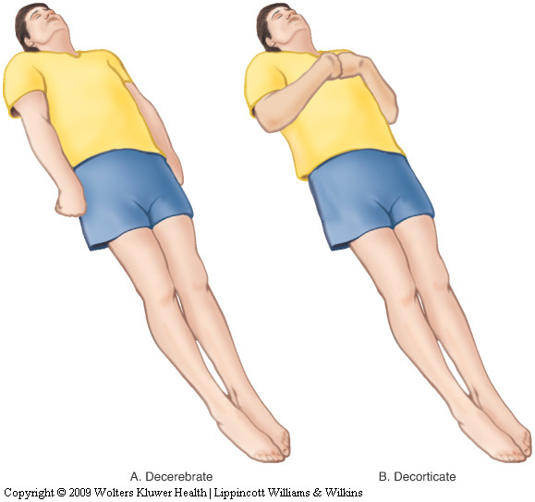
Emergency Injury Assessment (cont.)
Body posturing
Notes:
body position - athlete prone, supine, or side-lying? gross deformity in one of the limbs? severe brain injuries: a neurologic sign - “posturing” of the extremities; decerebrate rigidity - extension in all four extremities; decorticate rigidity - extension of the legs and marked flexion in the elbows, wrists, and fingers

Slide 31
Emergency Injury Assessment (cont.)
On-site palpation
General head-to-toe assessment
Determine
Abnormal joint angulation
Bony palpation
Soft tissue palpation
Skin temperature
Notes:
On-site palpation
abnormal joint angulation - identifies possible joint dislocation or fracture
bony palpation - possible fractures can be detected with palpation, percussion, vibration, compression, and distraction; crepitus - associated with fracture, swelling, or inflammation
soft tissue palpation - swelling may indicate diffuse hemorrhage or inflammation in a muscle, ligament, bursa, or joint capsule; deformity (e.g., an indentation) may indicate a rupture in a musculotendinous unit; protruding firm bulge may indicate a joint dislocation, ruptured bursa, muscle spasm, or hematoma
skin temperature - normally skin is dry, but certain conditions (e.g., cold, shock, or fever) can alter surface blood vessels; skin temperature is assessed by placing the back of the hand against the individual’s forehead or by palpating appendages bilaterally

Slide 32
Emergency Injury Assessment (cont.)
On-site functional testing
When not contraindicated, the individual’s willingness to move the injured body part
AROM, PROM, RROM
Weight bearing
On-site stress testing
Performed prior to any muscle guarding or swelling to prevent obscuring the extent of injury
Notes:
On-site functional testing
When not contraindicated, the athletic trainer should identify the individual’s willingness to move the injured body part; movements contraindicated in the presence of a possible head or spinal injury, fracture, dislocation, or muscle/tendon rupture.
AROM, PROM, RROM – normal protocol; RROM – use break test
Weight bearing – if the athlete successfully completes AROM, PROM, and RROM, may be permitted to walk off the field; otherwise, should be removed from the field in a non–weight-bearing manner.
On-site stress testing
Testing for ligamentous integrity is performed prior to any muscle guarding or swelling to prevent obscuring the extent of injury; typically, only single-plane tests are performed and then compared with the noninjured limb

Slide 33
Emergency Injury Assessment (Cont’d)
On-site neurologic testing
Critical to prevent a catastrophic injury
Areas
Cutaneous sensation
Motor function
Vital signs
Pulse
Variety of factors influence pulse
Count carotid for 30 seconds (and double it)
Normal ranges
Adults: 60-100
Children: 120-140
Notes:
On-site neurologic testing
Cutaneous sensation – normal protocol
Motor function – complete a cranial nerve assessment or ask the athlete to wiggle the fingers and toes on both hands and feet; compare grip strength in both hands
Vital signs
-- when warranted, assess to establish a baseline of information about the health status of the individual
-- indicate the status of the cardiovascular system and CNS
Pulse
-- factors such as age, gender, aerobic physical condition, degree of physical exertion, medications or chemical substances being taken, blood loss, and stress influence pulse
-- usually taken at the carotid artery because a pulse at that site is not normally obstructed by clothing, equipment, or strappings
-- aerobically conditioned athletes may have a pulse rate as low as 40 beats a minute

Slide 34
Emergency Injury Assessment (cont.)
Respiratory rate
Varies with gender and age
Count for 30 seconds (and double it)
Normal ranges
Adults: 10-25
Children: 20-25
Blood pressure
Pressure or tension of the blood within the systemic arteries
Changes in BP are very significant
Temperature
Normal = 98.6°F, but can fluctuate considerably
Methods
Notes:
Blood pressure
-- reflects the effectiveness of the circulatory system
-- may be affected by gender, weight, race, lifestyle, and diet
-- measured in the brachial artery with a sphygmomanometer and stethoscope
Systolic blood pressure
-- measured when the left ventricle contracts and expels blood into the aorta
-- approximately 120 mm Hg for a healthy adult and 125-140 mm Hg for healthy children aged 10 to 18
Diastolic blood pressure
-- residual pressure present in the aorta between heart beats
-- averages 70-80 mm Hg in healthy adults and 80-90 mm Hg in healthy children aged 10 to 18
Temperature
-- core temperature can be measured by a thermometer placed under the tongue, in the ear, in the armpit, or, in case of unconsciousness, in the rectum
Average oral temperature:
-- normal 37°C (98.6°F), but this can fluctuate considerably; early morning hours may fall as low as 35.8°C (96.4°F), and later afternoon or evening may rise as high as 37.3°C (99.1°F)
Rectal temperatures:
-- higher than oral temperatures by an average of 0.4 to 0.5°C (0.7 to 0.9°F)
-- considered to be a more accurate measurement of core temperature
Axillary temperatures:
-- lower than oral temperatures by approximately 1 degree
-- may take 5 to 10 minutes to register
-- considered less accurate than other measurements
Infrared tympanic thermometers (ITTs):
-- measure infrared energy emitted by the tympanic membrane
-- provide a rapid, efficient, and noninvasive method of measuring body temperature
-- have failed to detect fever in some patients with aids, neonates, infants, and children
-- not useful in hypothermic or significantly hyperthermic individuals

Slide 35
Emergency Injury Assessment (cont.)
Skin color
Can indicate abnormal blood flow and low blood oxygen concentration in a particular body part
Lightly pigmented individuals
Red, white, and blue
Dark-skinned individuals
Skin pigments mask cyanosis
Pupils
Sensitive to situations affecting the CNS
Pupillary light reflex
Eye movement
Tracking ability
Depth perception
Disposition
Can the situation be handled on-site, or should the individual be referred to a physician?
Notes:
Pupils
pupillary light reflex
-- rapid constriction of pupils when eyes are exposed to intense light
-- assessed by holding one hand over one eye and then moving the hand away quickly, or shining the light from a penlight into one eye and observing the pupil’s reaction
-- normal response - constriction with the light shining in the eye and dilation as light is removed
-- reaction is classified as brisk (normal), sluggish, nonreactive, or fixed
-- eyes may appear normal, constricted, unequal, or dilated
Testing eye movement
1) Ask the individual to focus on a single object
diplopia - individual sees two images instead of one; double vision; occurs when the external eye muscles fail to work in a coordinated manner
2) Ask the individual to watch your fingers move through the six cardinal fields of vision - assesses tracking ability
3) Place a finger several inches in front of the individual and ask the person to reach out and touch the finger - assesses depth perception (move the finger to several different locations)
Disposition
-- the final decision in any injury assessment is often very difficult; information gathered during the assessment must be analyzed and decisions made based on what is best for the injured individual
-- can the situation be handled on-site or should the individual be referred to a physician?
General rule: always refer individual to nearest trauma center or emergency clinic if:
-- any life-threatening situation is present
-- injury results in loss of normal function
-- no improvement is seen in an injury’s status after a reasonable amount of time

Slide 36
Emergency Injury Assessment (Cont’d)
Equipment considerations
Removal of any athletic helmet should be avoided unless individual circumstances dictate otherwise
Face mask removal
Should be removed prior to transportation, regardless of the current respiratory status
Helmet removal
Requires two trained individuals
Shoulder pad removal
Should not be removed unless life is in danger, and the threat outweighs the risk of a possible spinal cord injury from moving the athlete
Notes:
Separate PowerPoint available on helmet and shoulder pad removal.
Primary concern during an on-site assessment of an injured athlete is equipment, particularly with regard to removal of the athletic helmet; with a potential cervical spine injury, removal of a helmet may worsen the existing injury or lead to additional ones; removal of any athletic helmet should be avoided unless individual circumstances dictate otherwise
Considerations
-- removal of the face mask allows full airway access; plastic clips securing the face mask can be cut using special tools, permitting rapid removal
-- most injuries can be visualized with the helmet in place
-- neurologic tests can be performed with the helmet in place; eyes may be examined, the nose and ears checked for fluid or blood, and the level of consciousness determined
-- individual can be immobilized on a spine board with the helmet in place
-- helmet and shoulder pads elevate the supine athlete; removing the helmet without removing the shoulder pads results in cervical hyperextension
-- football helmets are radiographic translucent; therefore, a definitive diagnosis can be made prior to removal
Guidelines for removal of any piece of protective equipment should be jointly made by the athletic trainer, emergency medical technicians, and the team physician prior to the start of the season.
Situations were helmets may need to be removed might include:
-- when the helmet and chin strap do not hold the head securely so that immobilization of the helmet does not necessarily immobilize the head
-- when the design of the helmet and chin strap is such that even after removal of the face mask, the airway cannot be controlled
-- if the face mask cannot be removed after a reasonable amount of time
-- if the helmet prevents immobilization for transportation in an appropriate position
-- in extraordinary cases, such as when an automated external defibrillator (AED) is needed
AED use:
-- requires that the individual’s chest be fully exposed and dry
-- contact points for the defibrillator pads must be placed over the apex of the heart and inferior to the right clavicle
-- if pads touch wet shoulder pads, the defibrillator’s current could arc, leading to decreased effectiveness of the defibrillator, but more importantly, could defibrillate the operator
Facemask removal
-- typically attached to the helmet with four plastic clips
-- all four clips be cut so the facemask can be completely removed
-- commercial products to cut clips: anvil pruner, FM Extractor, Trainer’s Angel, PVC pipe cutter, X-Acto knife
-- regardless of how the facemask is removed, it is essential that in-line stabilization of the head and neck be maintained during the entire procedure
Helmet removal
-- requires two trained individuals
-- individual #1 will maintain in-line stabilization of the head and neck to minimize cervical spine movement
-- individual #2 begins by cutting the chin strap or straps; both cheek pads should then be removed; a flat object, such as a tongue depressor or the flat edge of tape scissors is slid between the helmet and cheek pad; a slight turn of the object will cause the cheek pad to unsnap from the helmet
-- individual #1 slips a finger in each ear hole and spread the helmet; next, slowly slips helmet off the head
-- individual #2 reaches behind the neck and provides firm support to the cervical spine & head
Shoulder pad removal
1) exposing chest without removing pads
-- shirt is cut to expose the shoulder pads; done by cutting the anterior portion of both sleeves
-- cut or unfasten the rib straps on the sternal portion of the pads
-- cut the laces holding together the anterior portions of the pad
-- the halves are then spread to expose the sternum
2) total removal
-- following above, the anterior and axillary shoulder straps are cut
-- the two halves of the shoulder pads are spread apart
-- as one individual continues to support the head, the shoulder pads are slid off shoulders over the head

Slide 37
Moving the Injured Participant
Ambulatory assistance
Aid an injured individual able to walk
Manual conveyance
Individual unable to walk or distance is too great to walk
Transport by spine board
Safest method
Notes:
Ambulatory assistance
-- implies that the injury is minor, and no further harm will occur if the individual is ambulatory
- two individuals of equal or near equal height should support both sides of the individual; individual drapes his/her arms across the shoulders of the assistants while their arms encircle the injured player’s back; assistants then escort the player off the field
Manual conveyance
- individual continues to drape his or her arms across the assistants’ shoulders, while one arm from each assistant is placed behind the individual’s back and the other arm is placed under the individual’s thigh; both assistants lift the legs up, placing the individual in a seated position; individual is then carried off the field
Transporting by spine board
-- ideally, five trained individuals should roll, lift, and carry an injured person
-- captain will stabilize the head and give commands for each person to slowly lift the injured individual onto the stretcher; individual is then secured onto the stretcher; on command, the stretcher is raised to waist level; individual should be carried feet first so the captain can constantly monitor the individual’s condition

Slide 38
Diagnostic Testing
The team physician or medical specialist orders tests and interprets the results
The athletic trainer should have a basic understanding of the purpose of the tests
Notes:
ATCs recognize a possible injury or illness based on their assessment and, as needed, refer the individual for further assessment.
Various forms of laboratory tests and imaging techniques may be used by the physician to assist in making their a diagnosis.

Slide 39
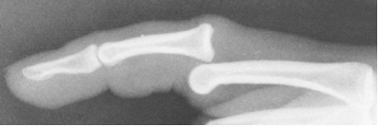
Diagnostic Testing (cont.)
Laboratory tests
Blood test, urinalysis
Radiographs (x-rays)
Can rule out fractures, infections, and neoplasms
Use of radio-opaque dyes
Myelogram
Arthrogram
Notes:
Radiographs
most common imaging technique is the radiograph or x-ray
- provides an image of certain body structures
Myelogram
uses an opaque dye that is introduced into the spinal canal through a lumbar puncture
can identify pathologies of the spinal canal (e.g., tumors, nerve root compression, and disc disease)
Arthrogram
opaque dye, air, or a combination of the two are injected into a joint space
can detect capsular tissue tears and articular cartilage lesions

Slide 40
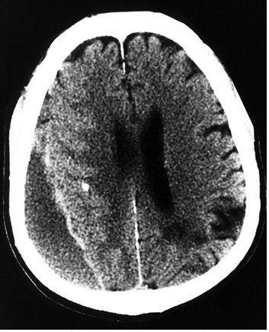
Diagnostic Testing (cont.)
Computed tomography (CT) scan
Can reveal abnormalities in bone, fat, and soft tissue
Can detect tendon & ligament injuries in varying joint positions
Notes:
CT scan
produces a “3-D” cross-sectional picture of a body part
relatively safe, since there is little radiation exposure during the procedure, and yields highly detailed results

Slide 41
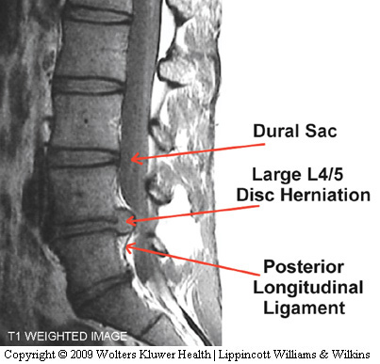
Diagnostic Testing (cont.)
Magnetic resonance imaging (MRI)
Can reveal soft tissue differentiation
Can demonstrate space-occupying lesions in the brain
Can demonstrate joint damage
Can view blood vessels and blood flow without use of a contrast medium
Notes:
CT scan
produces a “3-D” cross-sectional picture of a body part
relatively safe, since there is little radiation exposure during the procedure, and yields highly detailed results
MRI
excellent tool for visualizing the CNS, spine, and musculoskeletal and cardiovascular systems
soft tissue differentiation (i.e., ligamentous disruption; e.g., ACL tear)
space-occupying lesions in the brain (tumor or hematoma)
joint damage (meniscal tears, osteochondral fracture)
view blood vessels and blood flow without the use of a contrast medium (e.g., cardiac function)
in many cases, the MRI has replaced the myelogram and arthrogram

Slide 42
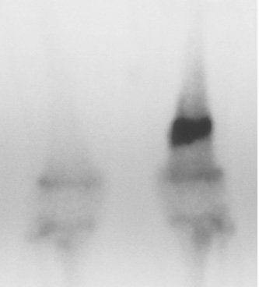
Diagnostic Testing (cont.)
Radionuclide scintigraph (bone scan)
Can detect stress fractures of the long bones and vertebrae, degenerative diseases, infections, or tumors of the bone
Notes:
Bone scans
may be clinically correlated to plain x-rays or other diagnostic tests
no special preparation is needed prior to the bone scan
risk to the patient is minimal

Slide 43
Diagnostic Testing (cont.)
Ultrasonic imaging
Used to view tendon and other soft tissue imaging
Electromyography
Used to detect denervated muscles, nerve root compression injuries, and other muscle diseases
Notes:
Ultrasonic imaging
sometimes called sonography
uses sound waves to view the various internal organs and certain soft tissue structures
commonly used to monitor development of the fetus during pregnancy
Electromyography
can detect certain muscular conditions

