Slide 1
Injury Assessment
Chapter 5

Slide 2
Injury Evaluation Process
Symptom
Information provided by the injured person regarding their perception of the problem
Sign
Objective, measurable physical finding

Slide 3
Injury Evaluation Process (cont.)
Establish a reference point by assessing the opposite, noninjured body part
Methods
HOPS
Subjective – history
Objective – observation, palpation, special tests
SOAP
Subjective and objective – same as HOPS
Additional – assessment and planning
Common abbreviations - refer to Table 5.1

Slide 4
Injury Evaluation Process (cont.)
Assessment
suspected site of injury, involved structures, and severity of injury
Establish long and short term goals
Plan
therapeutic modalities and exercises, educational consultations, and functional activities
Actionplan for achieving goals

Slide 5
Injury Evaluation Process (cont.)
All clinicians have an ethical responsibility to keep accurate and factual records
Injury Assessment Protocol – refer to Application Strategy 5.1

Slide 6
History of Injury
Can be most important step in assessment
Involves not only asking questions, but establishing a professional and comfortable atmosphere
Information provided is subjective, but should be gathered and recorded as quantitatively as possible
Document history in writing
Includes:
Primary complaint
Mechanism of injury
Characteristics of symptoms
Related medical history

Slide 7
History of Injury (cont.)
Primary complaint
What the individual believes is the current injury
Questions
Mechanism of injury
Attempt to visualize injury to identify possible injured structures
Questions

Slide 8
History of Injury (cont.)
Characteristics of symptoms
Location, onset, severity, frequency, duration, limitations due to pain
Questions
Pain
Somatic
Deep
Diffuse or nagging; with possible stabbing pain; longer lasting
Injury to bone, internal joint structures, or muscles
Superficial
Sharp, prickly; brief duration
Injury to skin
Visceral
Deep, nagging, and pressing; often accompanied by nausea and vomiting
Injury to internal organ
Referred pain

Slide 9
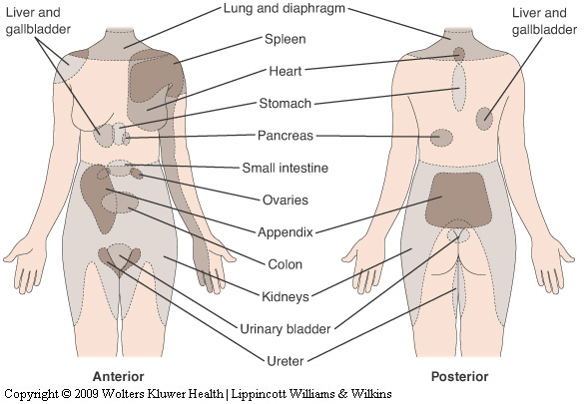
History of Injury (cont.)
Visceral organs can refer pain to specific cutaneous areas

Slide 10
History of Injury (cont.)
Disability resulting from injury
Determine limitations due to pain, weakness, or disability
Questions
Related medical history
Information regarding other problems/conditions potentially affecting this injury
Use of preseason physical exam

Slide 11
Observation and Inspection
Observation
Assess state of consciousness and body language that may indicate pain, disability, or other conditions
Note posture, willingness/ability to move, overall attitude
Symmetry and appearance
Congenital and functional problems
Gait
Motor function
Assess general motor function
Rule out injury to other joints

Slide 12
Observation and Inspection (cont.)
Inspection
Factors seen at the actual injury site (e.g., deformity, discoloration, swelling, signs of infection, scars)

Slide 13
Palpation
Prior to contact, permission must be granted to the AT to touch the patient
Bilateral palpation
Temperature
Swelling
Point tenderness
Crepitus
Deformity
Muscle spasm
Cutaneous sensation
Pulse
Gentle, circular pressure followed by gradual, deeper pressure
Begin away from injured site and move toward injury

Slide 14
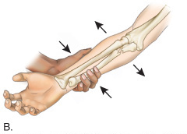
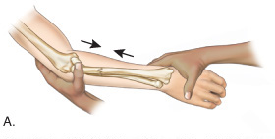
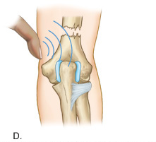
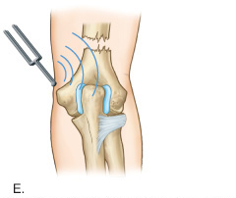
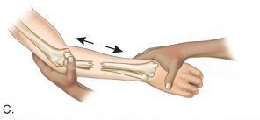
Palpation (cont.)
Determining a possible fracture

Slide 15
Physical Examination Tests
Functional testing
Objectively measure using goniometer
Age and gender may influence ROM
AROM
Joint motion performed voluntarily by the individual through muscular contraction
Perform before PROM
Indicates willingness and ability to move body part
Determines possible damage to contractile tissue; measures muscle strength and movement coordination
Measurement of all motions, except rotation, starts with the body in anatomic position

Slide 16
Physical Examination Tests (cont.)
PROM
The injured body part is moved through ROM with no assistance from the injured individual
Distinguishes injury to contractile tissues from noncontractile or inert tissues
End of the range, gentle overpressure to determine end feel
Differences in ROM between AROM and PROM
Accessory movements
Loose-packed position
Close-packed position

Slide 17
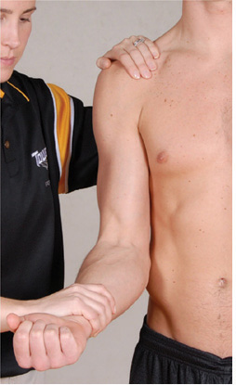
Physical Examination Tests (cont.)
RROM
Can assess muscle strength and detect injury to the nervous system
Break test or entire ROM

Slide 18
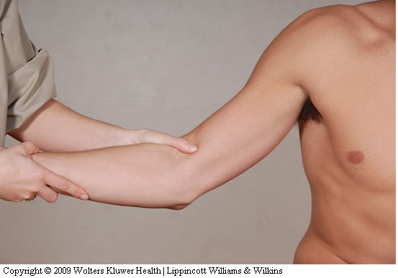
Physical Examination Tests (cont.)
Ligamentous and capsular testing
Assess joint function and integrity of joint structures
Laxity vs. instability
Test at proper angle

Slide 19
Physical Examination Tests (cont.)
Neurologic testing
Nerve root
Somatic
Visceral
CNS: assess using dermatomes, myotomes, and reflexes
Dermatome – area of skin supplied by a single nerve root
Assess sensation
Abnormal: hypoesthesia, hyperesthesia, paresthesia

Slide 20
Physical Examination Tests (cont.)
The cutaneous sensation patterns of the spinal nerves’ dermatomes differ from the patterns innervated by the peripheral nerves.

Slide 21
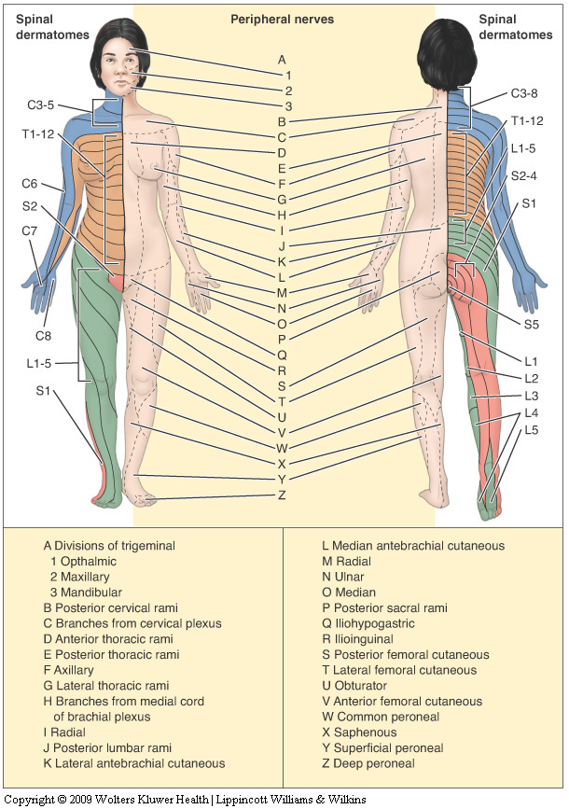
Physical Examination Tests (cont.)

Slide 22
Physical Examination Tests (cont.)
Neurologic testing (cont.)
myotome – group of muscles primarily innervated by a single nerve root
Assess muscle contraction (hold at least 5 seconds)
Abnormal: paresis, paralysis

Slide 23
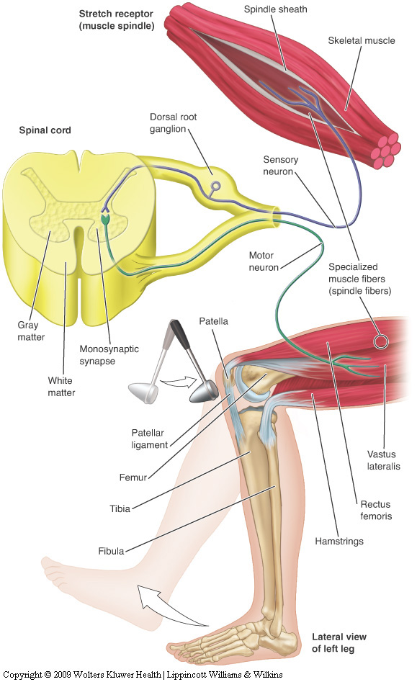
Physical Examination Tests (cont.)
Neurologic testing (cont.)
Reflexes
DTRs
Abnormal: diminished, exaggerated or distorted, absent
Superficial reflexes
Pathologic

Slide 24
Physical Examination Tests (cont.)
Peripheral nerve testing
Manual muscle testing
Cutaneous sensation testing
Special compression tests
Activity-specific functional testing
Typical, active movements performed during activity participation
Movements should assess: strength, agility, flexibility, joint stability, endurance, coordination, balance, and sport-specific skill performance

Slide 25
Emergency Medical Services System
Process that activates the emergency health care services of the athletic training facility and community to provide immediate health care to an injured individual
The team physician, athletic trainer, and coach have a legal duty to develop and implement an emergency plan to provide health care for participants

Slide 26
Emergency Medical Services System (cont.)
Preseason preparation
Meet with representatives from local EMS agencies to discuss, develop, and evaluate plan
Written plan for each activity site
Practice the emergency plan
Responsibilities of medical personnel
Team physician
Prior to season, delineate responsibilities of all personnel
On-the-field
Athletic trainer
Event set-up
Home vs. away
Presence or absence of physician

Slide 27
Emergency Injury Assessment
Primary survey
Determines level of responsiveness
Identifies immediate life-threatening situations (ABCs)
Dictates necessary actions
Triage
Rapid assessment of all injured individuals followed by return to the most seriously injured for treatment
Charge person vs. call person
“Red flags”
On-site assessment; ascertain presence of serious or moderate injury

Slide 28
Emergency Injury Assessment (cont.)
On-site history
Obtained from the individual or bystanders who witnessed the injury
Relatively brief as compared to a comprehensive clinical evaluation
Critical areas (refer to Field Strategy 5.6)
Location of pain
Presence of abnormal neurologic signs
Mechanism of injury
Associated sounds
History of the injury

Slide 29
Emergency Injury Assessment (cont.)
On-site observation and inspection
Begin en route to individual
Critical areas
Surrounding area
Body position
Movement of the athlete
Level of responsiveness
Primary survey
Inspection for head trauma
Inspection of injured body part

Slide 30
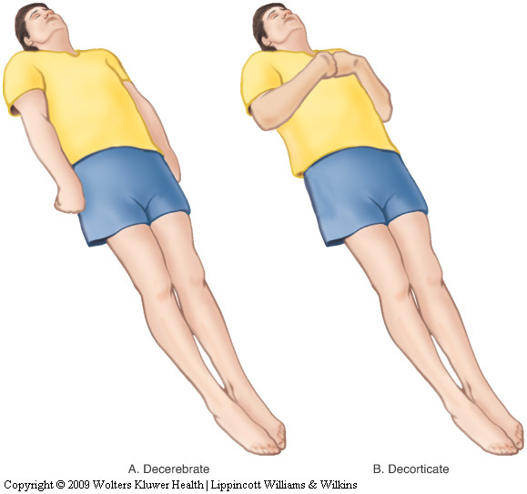
Emergency Injury Assessment (cont.)
Body posturing

Slide 31
Emergency Injury Assessment (cont.)
On-site palpation
General head-to-toe assessment
Determine
Abnormal joint angulation
Bony palpation
Soft tissue palpation
Skin temperature

Slide 32
Emergency Injury Assessment (cont.)
On-site functional testing
When not contraindicated, the individual’s willingness to move the injured body part
AROM, PROM, RROM
Weight bearing
On-site stress testing
Performed prior to any muscle guarding or swelling to prevent obscuring the extent of injury

Slide 33
Emergency Injury Assessment (Cont’d)
On-site neurologic testing
Critical to prevent a catastrophic injury
Areas
Cutaneous sensation
Motor function
Vital signs
Pulse
Variety of factors influence pulse
Count carotid for 30 seconds (and double it)
Normal ranges
Adults: 60-100
Children: 120-140

Slide 34
Emergency Injury Assessment (cont.)
Respiratory rate
Varies with gender and age
Count for 30 seconds (and double it)
Normal ranges
Adults: 10-25
Children: 20-25
Blood pressure
Pressure or tension of the blood within the systemic arteries
Changes in BP are very significant
Temperature
Normal = 98.6°F, but can fluctuate considerably
Methods

Slide 35
Emergency Injury Assessment (cont.)
Skin color
Can indicate abnormal blood flow and low blood oxygen concentration in a particular body part
Lightly pigmented individuals
Red, white, and blue
Dark-skinned individuals
Skin pigments mask cyanosis
Pupils
Sensitive to situations affecting the CNS
Pupillary light reflex
Eye movement
Tracking ability
Depth perception
Disposition
Can the situation be handled on-site, or should the individual be referred to a physician?

Slide 36
Emergency Injury Assessment (Cont’d)
Equipment considerations
Removal of any athletic helmet should be avoided unless individual circumstances dictate otherwise
Face mask removal
Should be removed prior to transportation, regardless of the current respiratory status
Helmet removal
Requires two trained individuals
Shoulder pad removal
Should not be removed unless life is in danger, and the threat outweighs the risk of a possible spinal cord injury from moving the athlete

Slide 37
Moving the Injured Participant
Ambulatory assistance
Aid an injured individual able to walk
Manual conveyance
Individual unable to walk or distance is too great to walk
Transport by spine board
Safest method

Slide 38
Diagnostic Testing
The team physician or medical specialist orders tests and interprets the results
The athletic trainer should have a basic understanding of the purpose of the tests

Slide 39
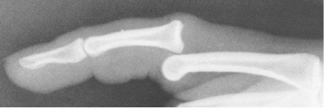
Diagnostic Testing (cont.)
Laboratory tests
Blood test, urinalysis
Radiographs (x-rays)
Can rule out fractures, infections, and neoplasms
Use of radio-opaque dyes
Myelogram
Arthrogram

Slide 40
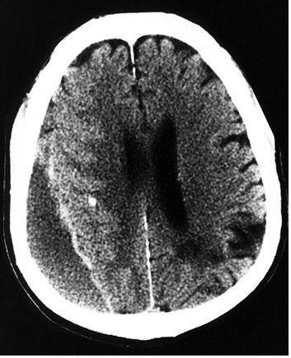
Diagnostic Testing (cont.)
Computed tomography (CT) scan
Can reveal abnormalities in bone, fat, and soft tissue
Can detect tendon & ligament injuries in varying joint positions

Slide 41
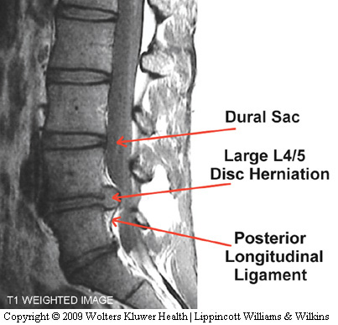
Diagnostic Testing (cont.)
Magnetic resonance imaging (MRI)
Can reveal soft tissue differentiation
Can demonstrate space-occupying lesions in the brain
Can demonstrate joint damage
Can view blood vessels and blood flow without use of a contrast medium

Slide 42
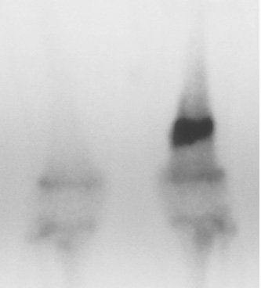
Diagnostic Testing (cont.)
Radionuclide scintigraph (bone scan)
Can detect stress fractures of the long bones and vertebrae, degenerative diseases, infections, or tumors of the bone

Slide 43
Diagnostic Testing (cont.)
Ultrasonic imaging
Used to view tendon and other soft tissue imaging
Electromyography
Used to detect denervated muscles, nerve root compression injuries, and other muscle diseases

